Slide 1

Stock Purchasing Financial Analysis
Project 2
Jabin Barcelo
Derek Herr
Karina Manzo
Kristina Valenzuela

Slide 2
Stock Analysis
Hypothesis
We will use 3 key indicators to be able to make stock purchase and sell recommendations based on historical stock pricing data.
Historical Stock Data from Yfinance API
We used a code to generate multiple csv files for a range of the past 5 years
Data Range – 5 years
Train Data – 2016 – 2019
Test Data - 2020

Slide 3
Data Gathering
We ran a coding algorithm to pull tickers from Yfinance, based on specific market cap
We then used a for-loop program to create csv files for each of the tickers.

Slide 4
3 Key Signals
MACD (Moving Average Convergence Divergence)
Analysis of the difference between the 12-day & 26-day Exponential Moving Average, overlayed on the 9-day Exponential moving Average. Signals are the points at which these lines cross
RSI (Relative Strength Index)
Evaluation of recent pricing fluctuations to determine whether a security is being overbought or oversold.
Momentum
Acceleration of a security’s price or volume. Relies on short-term movements over fundamental value

Slide 5
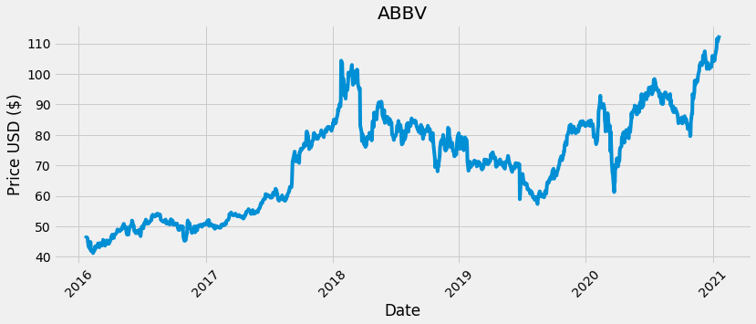
AbbVie Inc (ABBV)
Historical Pricing

Slide 6
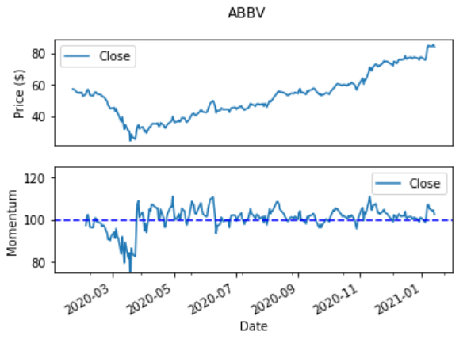
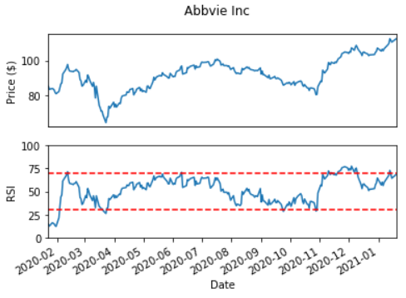
AbbVie Inc (ABBV)
Momentum & RSI

Slide 7
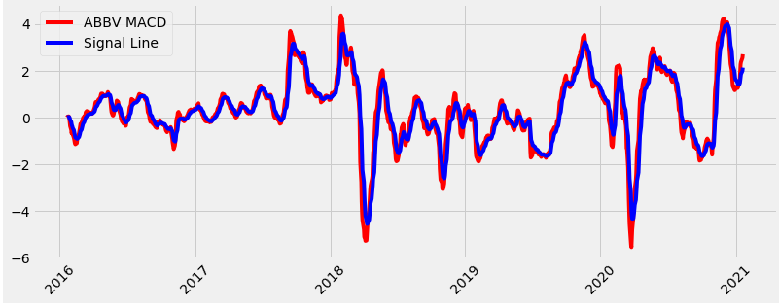
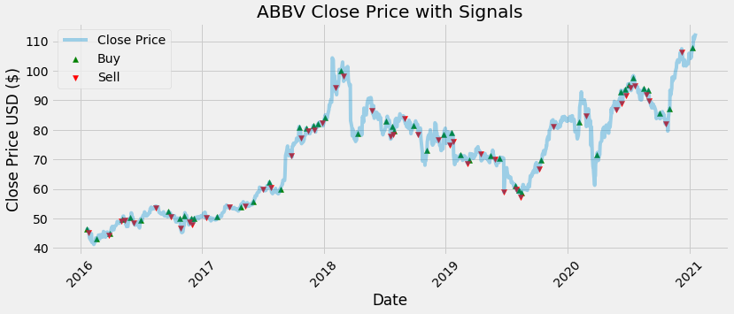
AbbVie Inc (ABBV)
MACD Signal Plots

Slide 8
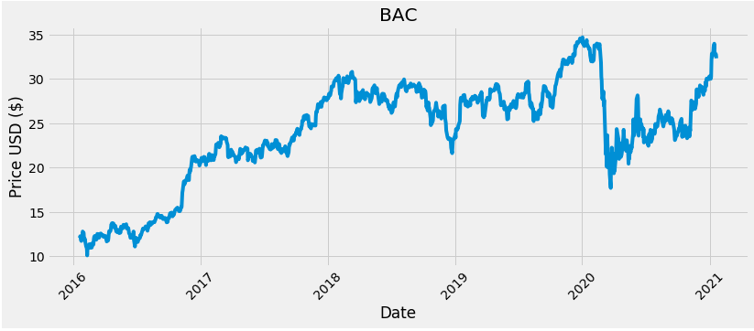
Bank of America Corp (BAC)
Historical Pricing

Slide 9
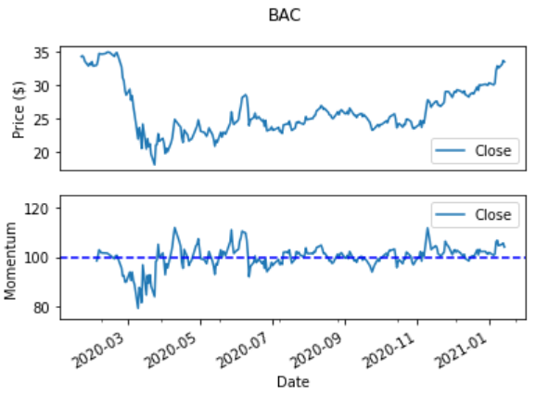
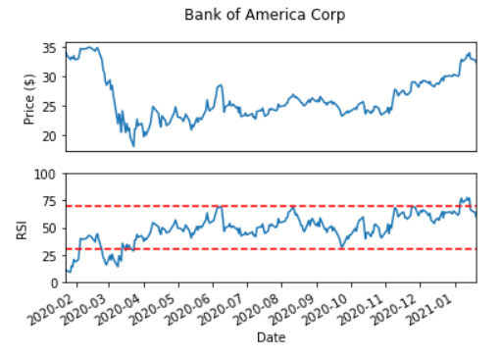
Bank of America Corp (BAC)
Momentum & RSI

Slide 10
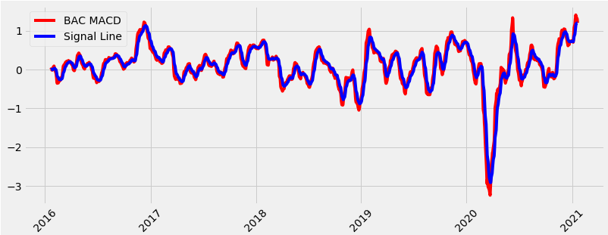
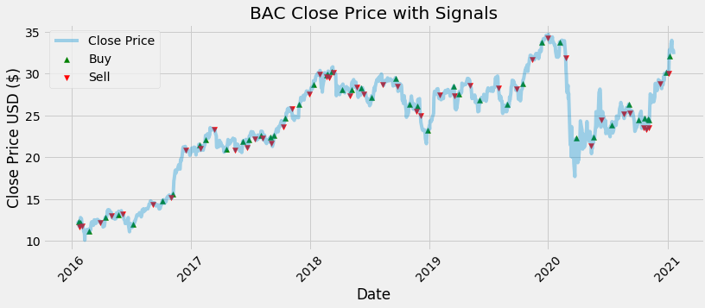
Bank of America Corp (BAC)
MACD Signal Plots

Slide 11

Chevron Corporation (CVX)
Historical Pricing

Slide 12
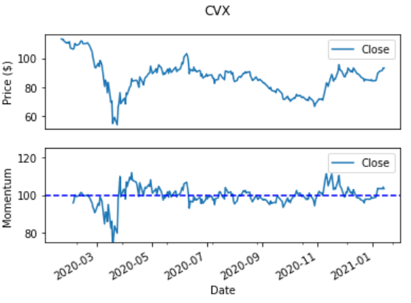
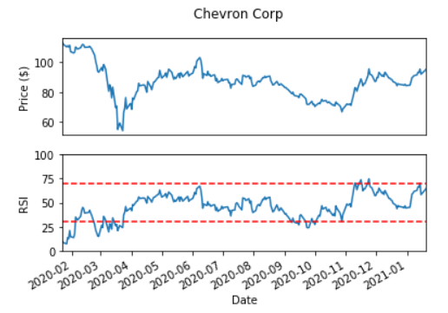
Chevron Corporation (CVX)
Momentum & RSI

Slide 13
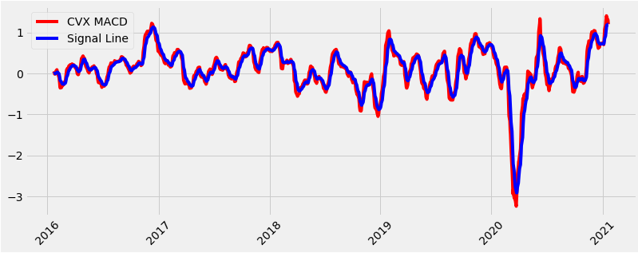
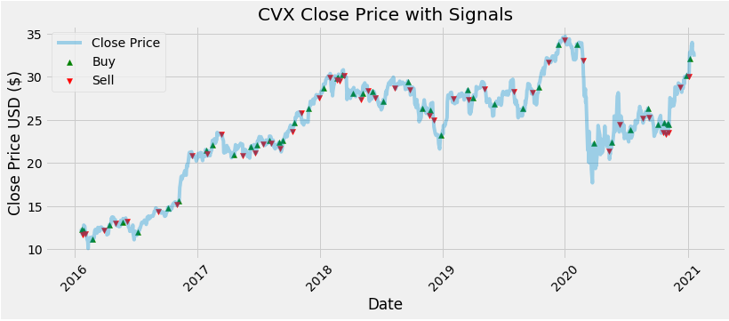
Chevron Corporation (CVX)
MACD Signal Plots

Slide 14
Machine Learning
Testing & Training
We used the data from 2016 – 2019 to train the model, and tested it based on the data from 2020

Slide 15
Testing & Training Data
The way the model works is that it signals a buy at the first time the signals all meet the criteria. Then it will not signal a sell until all 3 align again. This creates a more positive prediction than what actually occurs.

Slide 16
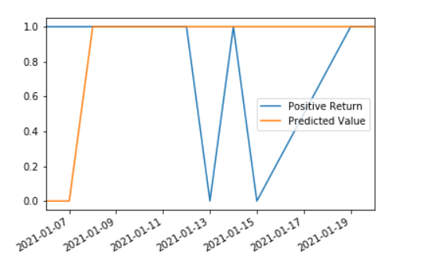
Predictions

Slide 17
Results
We found these signals not to be incredibly accurate, as ABBV, as a predictive value was often positive, when actual results were not.
This might not be a beneficial strategy for short-term traders.

